Slide 1

Usability Evaluation of AliExpress
Guided By Dr. Abbas Moallem | Presented By: Musketeers Mohit Shah Prakruthi Suresh Sheethal Halandur Nagaraja Shreya Shah

Slide 2
Product Selection & Description
AliExpress being an e-commerce website significantly involves a user’s interaction with computing technology
Business to consumer and consumer to consumer platform providing access to the international market to Chinese sellers
Most visited e-commerce website in Russia

Slide 3
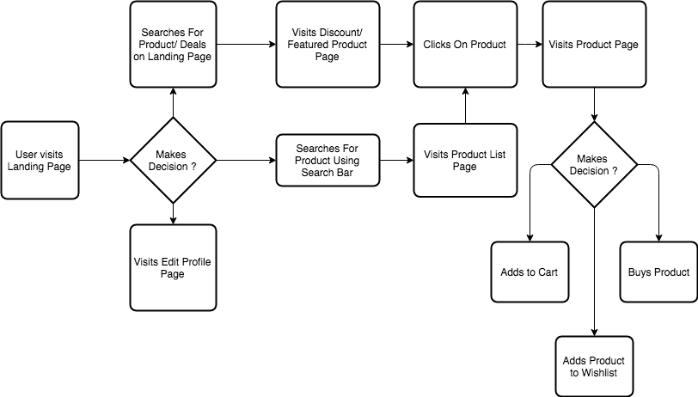
System Flow

Slide 4
Searching For Product (Interface Evaluation)
Always present at the top of all web pages
Good Usability as it is intuitive and fast to access

Slide 5
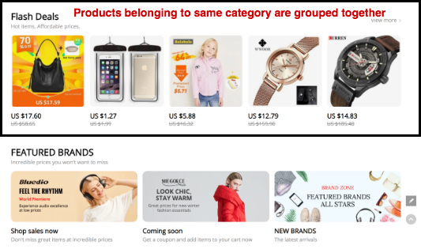
Landing Page (Interface Evaluation)
Products having common characteristics (under discount, similar categories, etc.) are grouped together

Slide 6
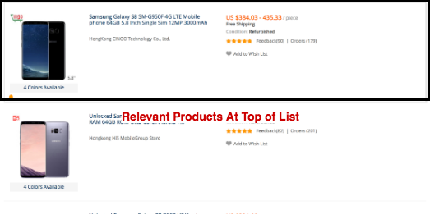
Product List (Interface Evaluation)
Asa
Products are displayed from top to bottom in order of relevance hence this design is very intuitive.
Users have a tendency to scan from top to bottom.

Slide 7
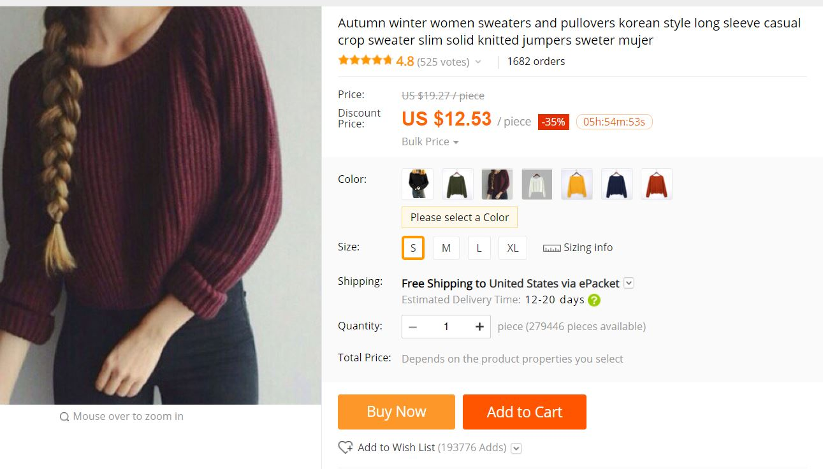
Purchasing a Product (Interface Evaluation)
There is good affordance in the “Buy Now” and “Add to Cart” buttons.

Slide 8
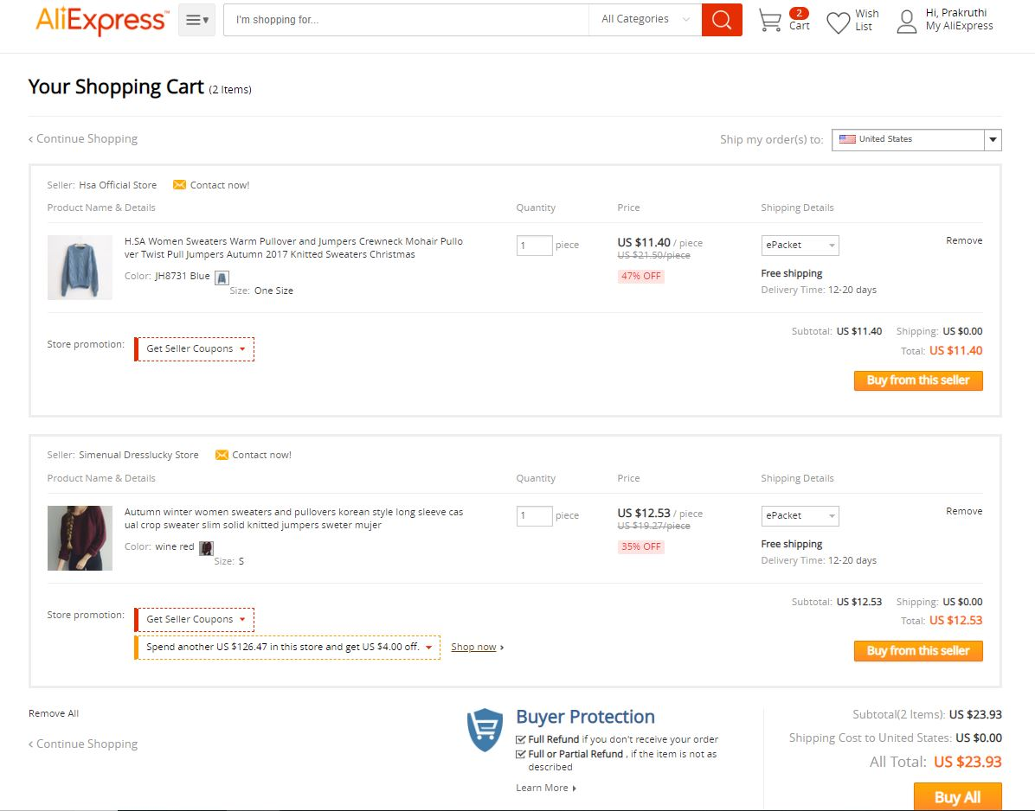
Purchasing a Product (Interface Evaluation)
The buy buttons are distinctly colored thus making the task flow easily detectable.

Slide 9
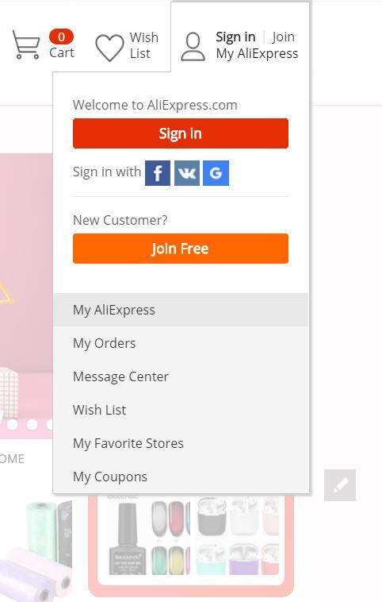
Managing User Profiles(Interface Evaluation)
Multiple Sign in and Join options in landing page
Redundant information on title bar with no action associated

Slide 10
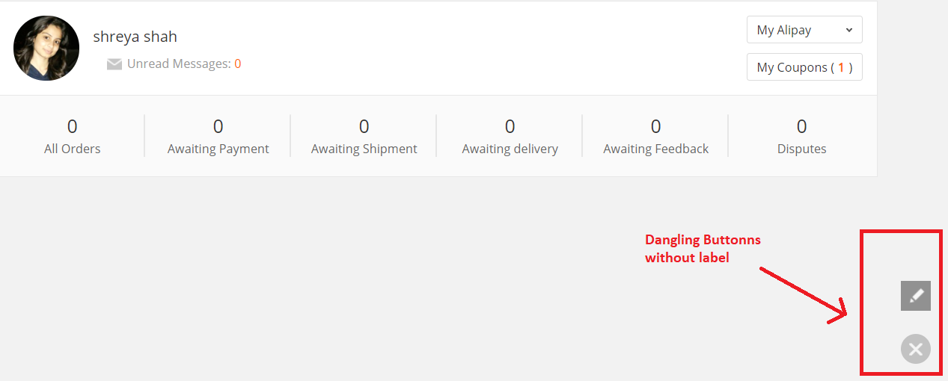
Managing User Profiles (Interface Evaluation)
Icon action is not intuitive to the user
Clicking on it open user feedback page which is irrelevant to context

Slide 11
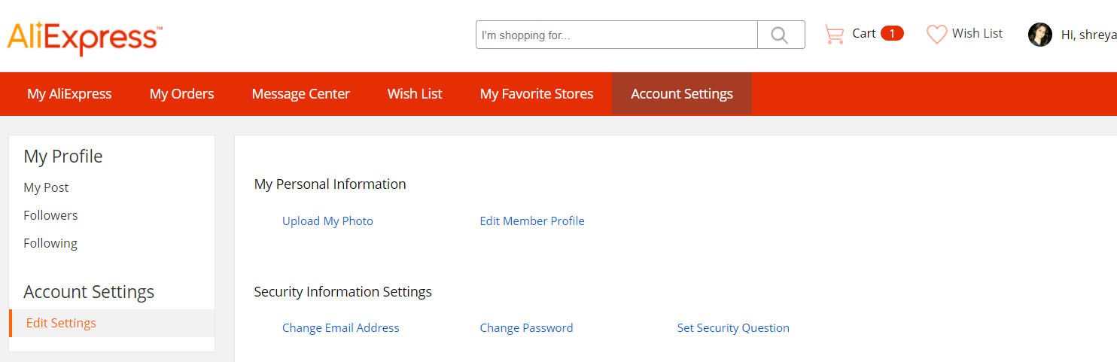
Managing User Profiles (Interface Evaluation)
Intuitive labeling for menu items
Simple design

Slide 12
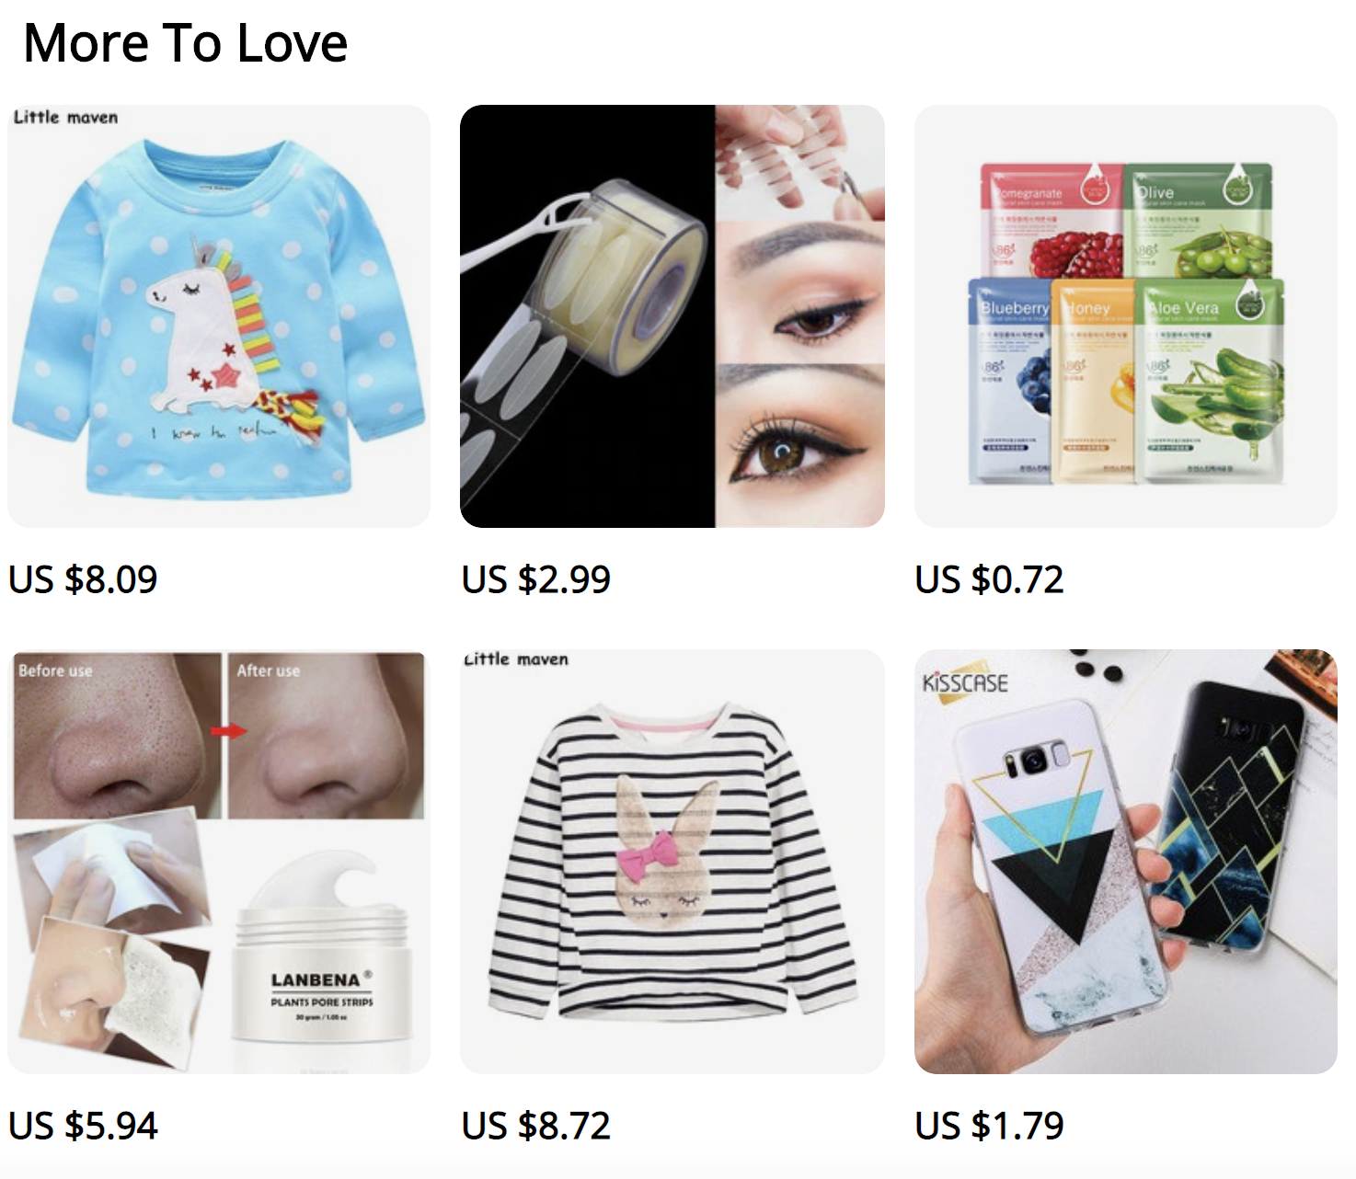
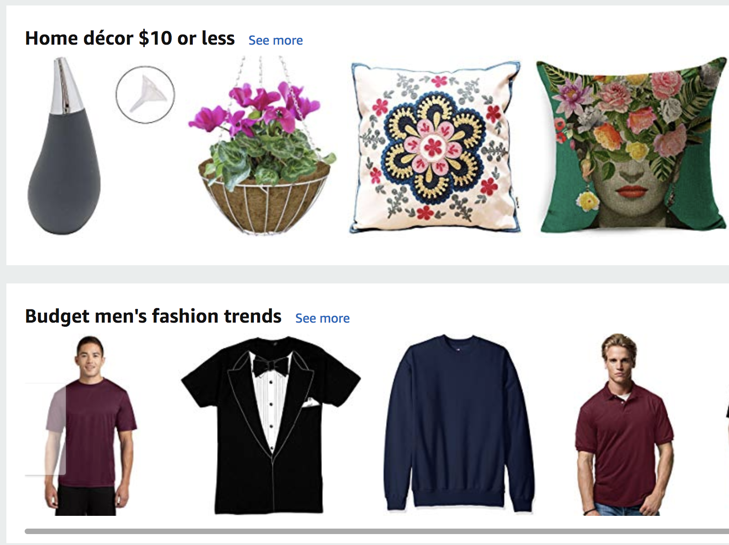
Searching For Product (Comparative Study)
AliExpress Landing Page Section | Amazon Landing Page Section
AliExpress landing page sections lacks proper grouping
Amazon grouping makes recommendations useful

Slide 13
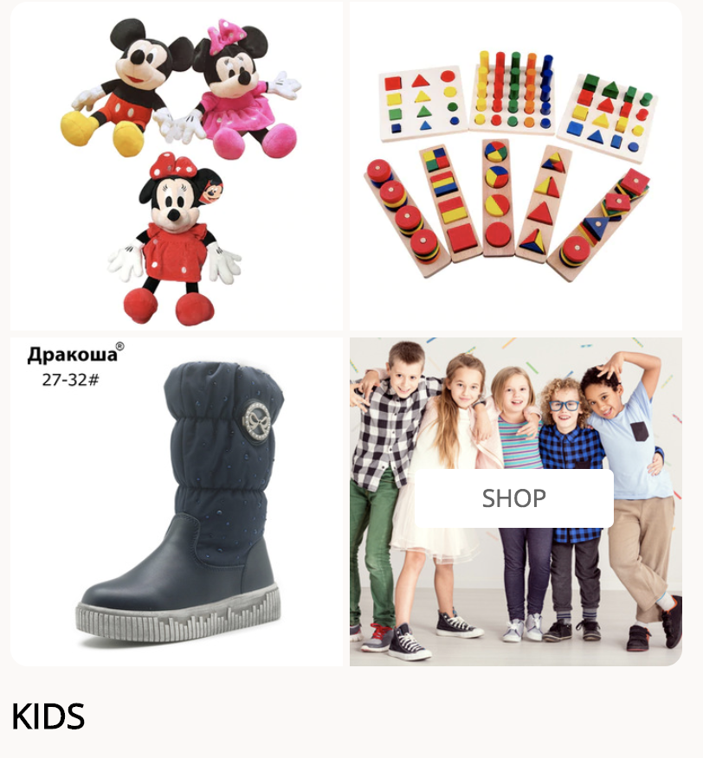
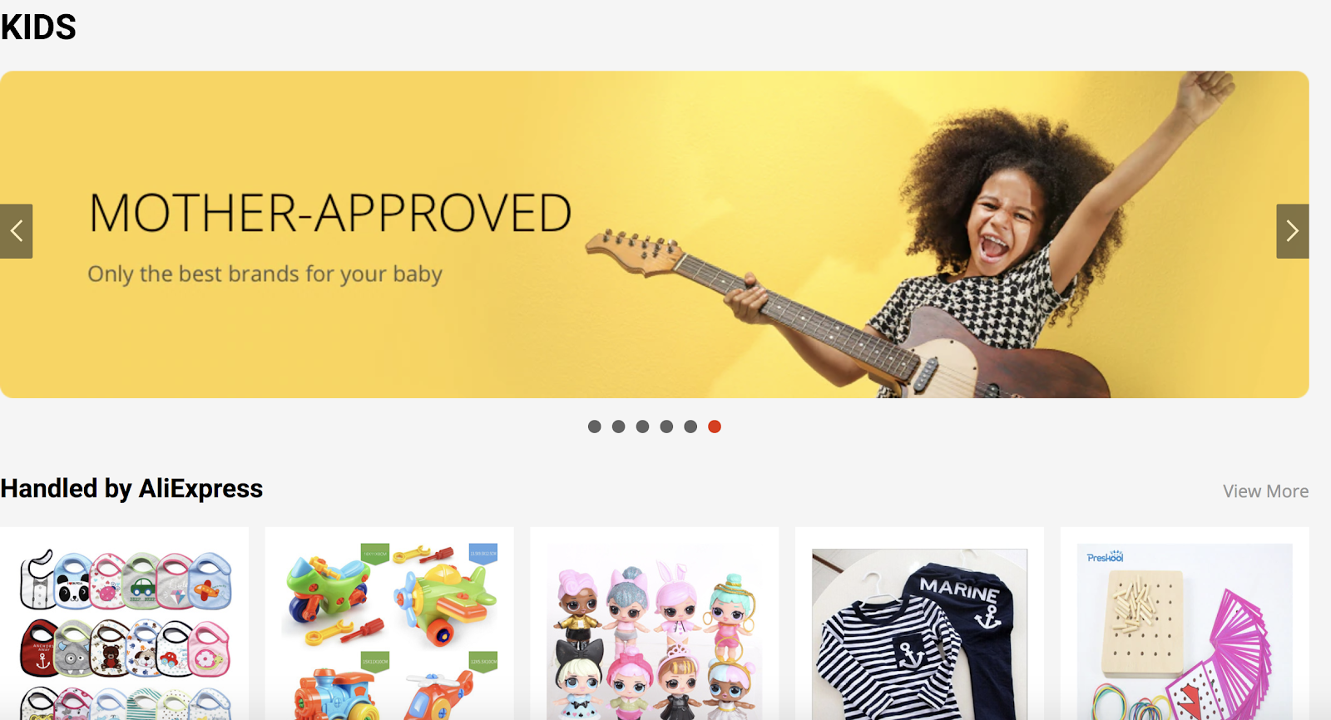
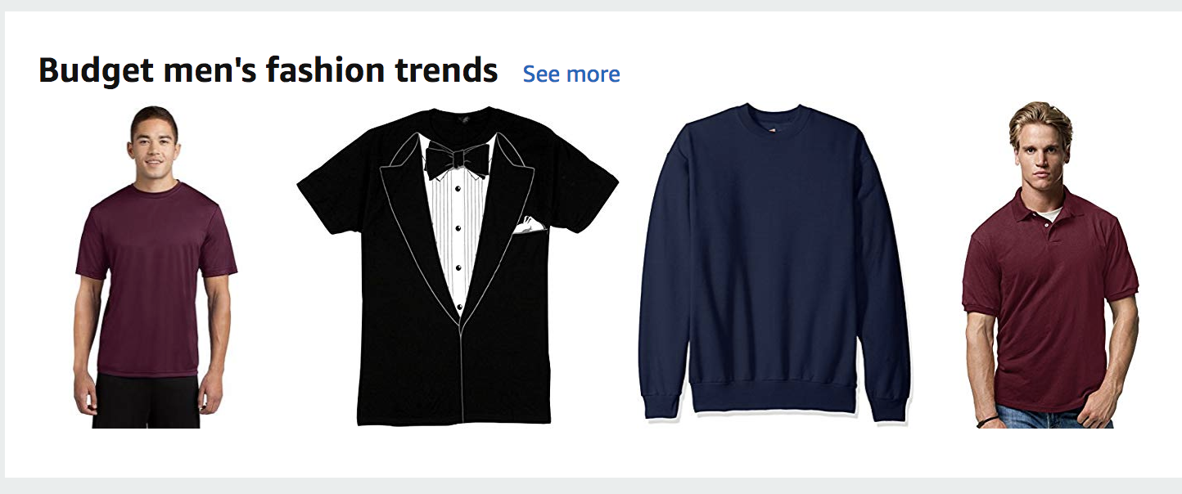
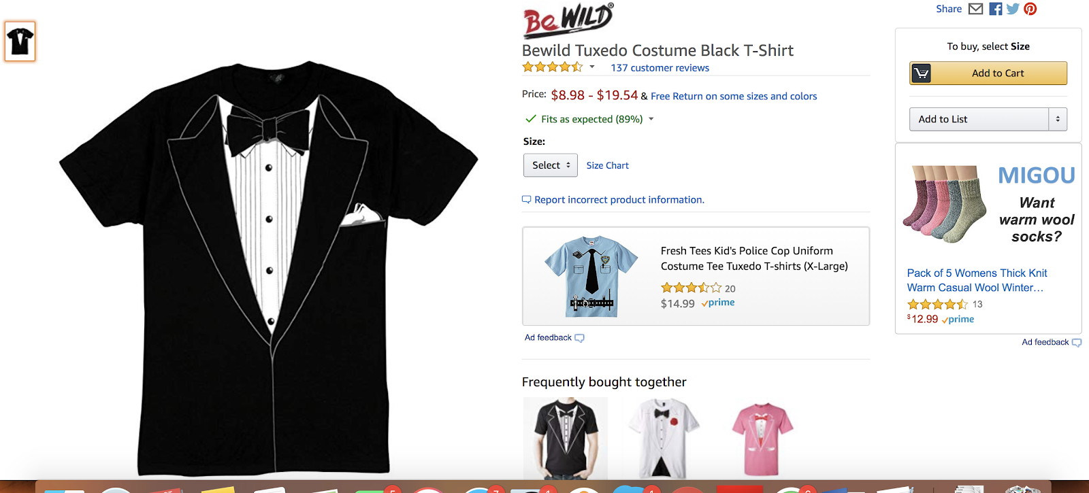
Searching For Product (Comparative Study)
AliExpress :Clicking on anything takes user to picture on the right | AliExpress Kids Section is a Separate Page instead of a product page
Amazon : Clicking on any picture takes to a specific product page | Amazon Product Page

Slide 14
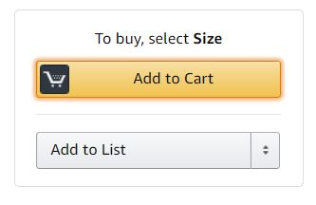
Purchasing Product (Comparative Study)
Prompt for selecting color is not immediately discoverable | Prompt for selecting size is clearly visible because it appears near the action button
Related pieces of information placed together in Amazon

Slide 15
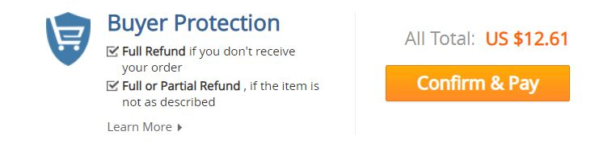
Purchasing Product (Comparative Study)
AliExpress-Progress bar indicates step one but the “confirm & pay” indicates final step | The shopping cart icon indicates what step user is on
AliExpress has poor feedforward

Slide 16
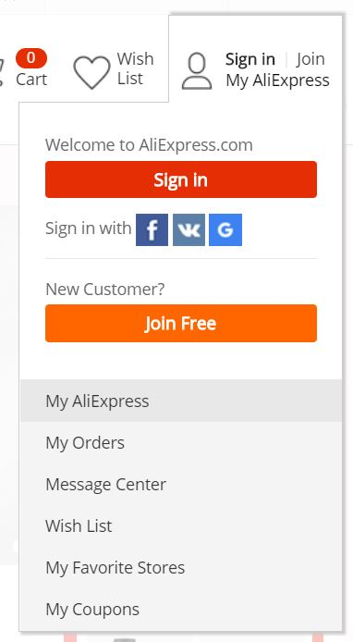
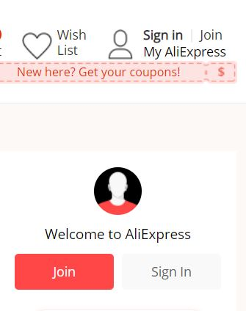
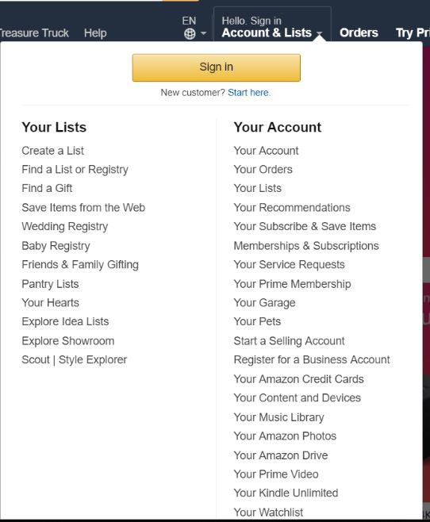
User Accounts (Comparative Study)
AliExpress Sign In/Join Display | Amazon Sign In Display
In Amazon, hovering over “Hello, Sign In” on landing page displays clear option to “Sign in” for existing users and “Start here” for new users.
On AliExpress, Extra clicks for Sign-In and Join and Redundant Links.

Slide 17
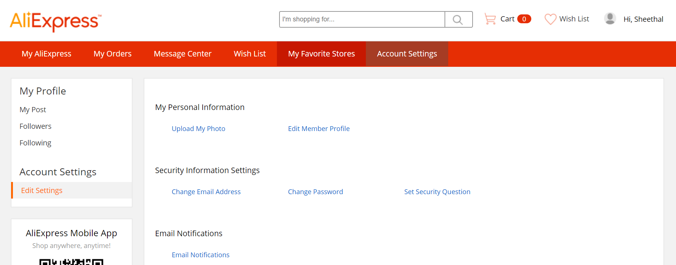
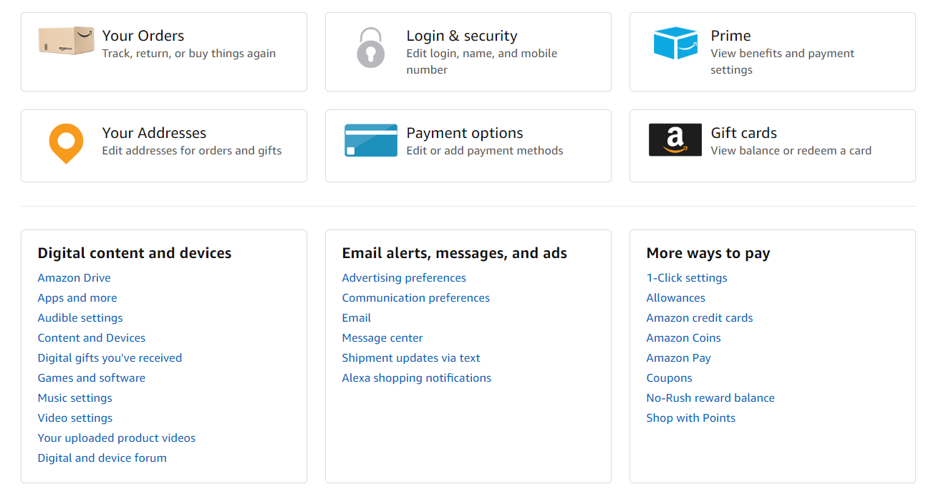
Manage User Profile (Comparative Study)
AliExpress Account Settings | Amazon Account Settings
In Amazon, No intuitive labelling for account management.
On AliExpress, Labelling is clear and intuitive.

Slide 18
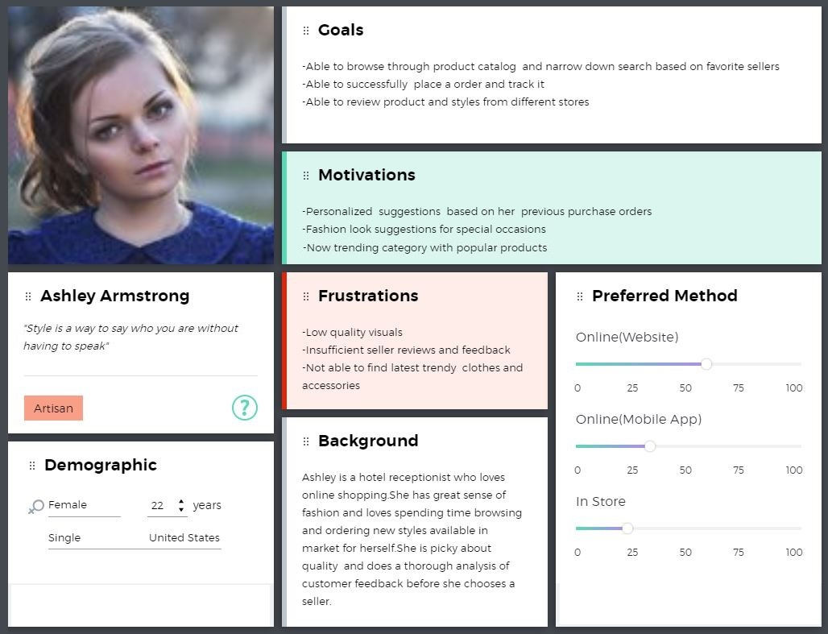
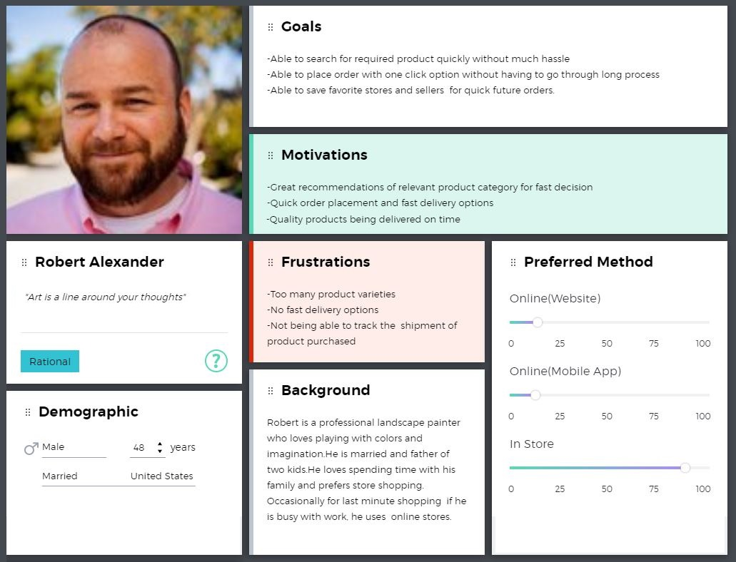
User Profiling
Persona-1 : Frequent Online Shopper
Able to browse through product quickly and narrow down search based on favorite seller.
Frustration – Less Options for latest Trends.
Persona–2 : Prefers Shopping in-store over Online
Ability to search for the specific product quickly without much hassle.
Frustration – Too many product varieties.

Slide 19
Usability Metrics
Quantitative Metrics
Task time
Satisfaction rates
Perceived usefulness rates
Qualitative Metrics
Nielsen's 10 heuristics for user interface design
Usability goal
Expectations
Frustration

Slide 20

Usability (Qualitative) Metrics
First Impression Interview
First Impression Interview
1
Two open ended questions were asked to Participants showing the first view of the website.
2
Expectations and score points were taken considering the features participants wish to have on the application.
3

Slide 21
Usability (Qualitative) Metrics
Heuristic Evaluation
Nielsen’s Ten Heuristic Principles
Aesthetic and minimalist design
Help and documentation
Flexibility and efficiency of use
Recognition rather than recall
Consistency and standards
User control and freedom
Match between system and the real world
Visibility of system status
Help users recognize, diagnose, and recover from errors
Error prevention

Slide 22
Usability (Qualitative) Metrics
Heuristic Evaluation
Nielsen’s Ten Heuristic Principles
Aesthetic and minimalist design
Help and documentation
Flexibility and efficiency of use
Recognition rather than recall
Consistency and standards
User control and freedom
Match between system and the real world
Visibility of system status
Help users recognize, diagnose, and recover from errors
Error prevention

Slide 23
Usability Metrics
User Testing using Think Aloud Technique
Participants were asked to perform 2 tasks and speak their thoughts out loud.
A follow-up survey was administered.
Quantitative and Qualitative metrics were obtained.

Slide 24
Usability Metrics
Quantitative Data
Description | Participants’ Responses
Task Time | Range: 3 to 10 minutes Average: 6 minutes
Participants did not notice prompt to pick color or size of the product | 2/5
Participants complained about menus and filters | 2/5
Participants complained about product titles | 2/5

Slide 25
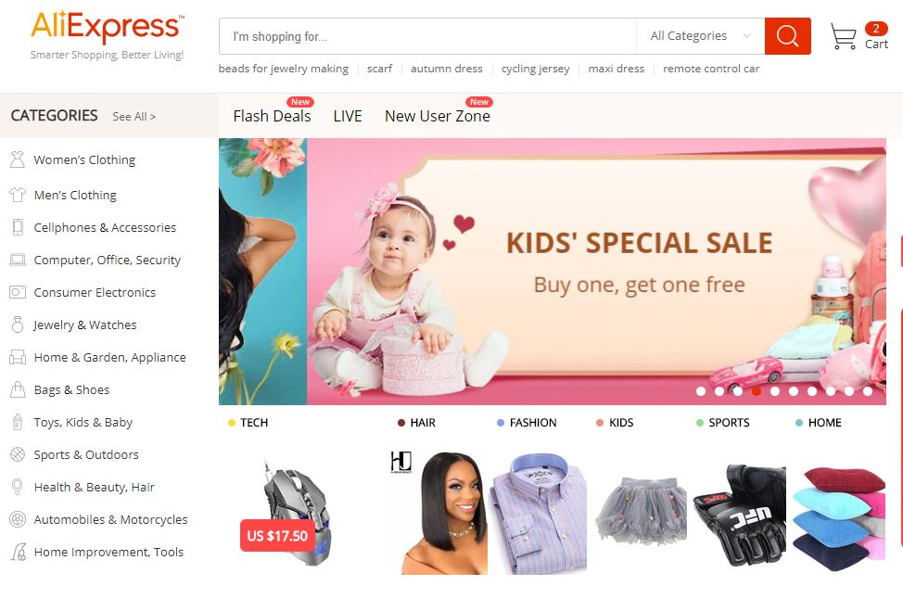
Usability Metrics
Qualitative Data
Some complaints – Too much information

Slide 26
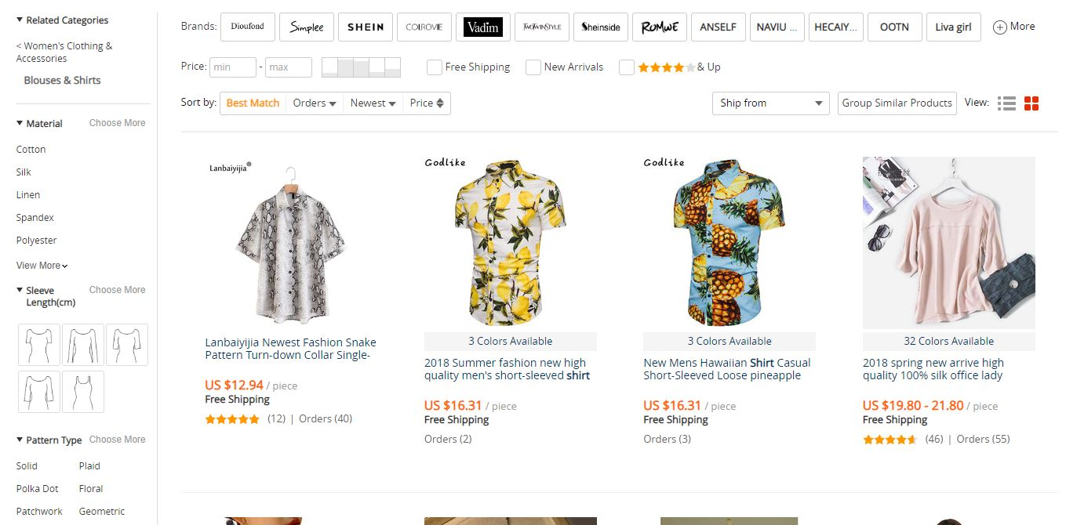
Usability Metrics
Qualitative Data
Some complaints – grouping of filters

Slide 27
Usability (Qualitative) Metrics
Heuristic Evaluation
Nielsen’s Ten Heuristic Principles
Aesthetic and minimalist design
Help and documentation
Flexibility and efficiency of use
Recognition rather than recall
Consistency and standards
User control and freedom
Match between system and the real world
Visibility of system status
Help users recognize, diagnose, and recover from errors
Error prevention

Slide 28
Usability Enhancements
Improve Discoverability of Feedback/Error Messages

Slide 29
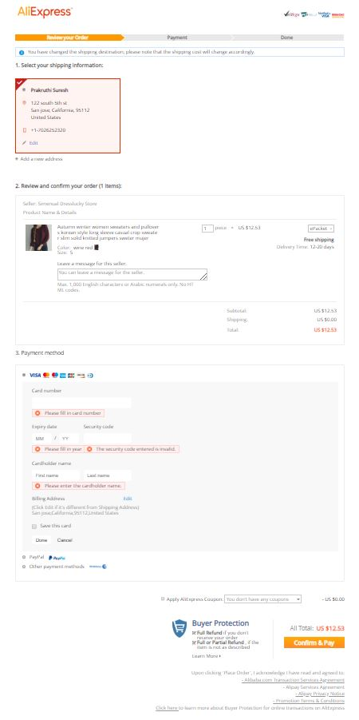
Usability Enhancements
Improve Feedforward

Slide 30
Usability Enhancements
Improve Grouping of Filters

Slide 31
Conclusion
Uncover pain-points of users.
Provide recommendations to improve usability and design to meet user requirements.

Slide 32
Thank you!

